Slide 1

Toward simple and scalable 3d cell tracking
Mojtaba S. Fazli ¹, Steven A.Vella ², Silvia N.J.Moreno ², Garry E. Ward ³, Shannon Quinn ^{1,2}
1 Department of Computer Science, The University of Georgia, GA, USA
2 Department of Cellular Biology, The University of Georgia, GA, USA
3 Department of Microbiology and Molecular Genetics, The University of Vermont, VT, USA
Open Science in Big Data Workshop – IEEE Bigdata 2018, Seattle, WA
Dec, 10,2018
Notes:
Capitalize “u” in University of Vermont
Also look up two-letter abbreviation for Vermont (I believe it’s “VT”)

Slide 2

Toxoplasma gondii
an intracellular parasite that invades host cells, hijacks the cellular machinery, and replicates before egress and subsequent invasion
the causative agent of disseminated toxoplasmosis, which is considered as one of the most successful parasitic infections; more than 1/3 of the world’s population has been or is infected.
For infants, elderly, neonatal fetuses, and individuals with weak or compromised immune systems, T. gondii can cause deadly complications.
T. gondii’s virulence and ability to invade host cells is linked to its lytic cycle.
The image is downloaded from https://www.istockphoto.com/photo/toxoplasma-gondii-awareness-conceptual-image-gm874063668-244075790

Slide 3
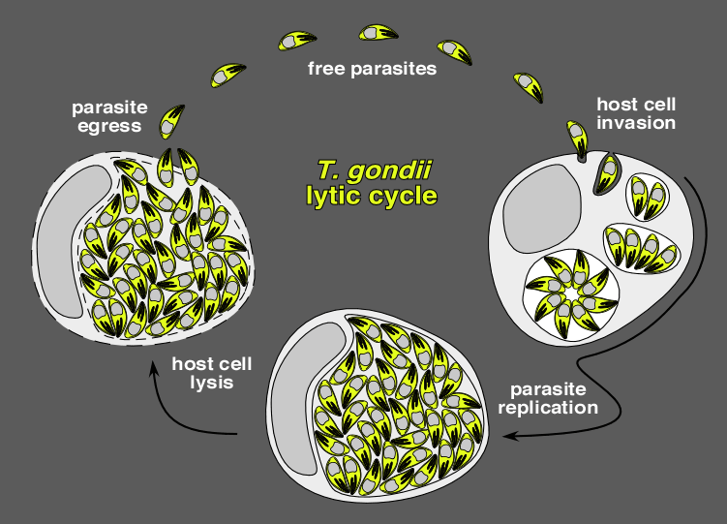
Why we study the Moyility of the parasite ?
Motility is essential for lytic cycle because :
Move to find a host cell to invade
The actual process of invasion to go into a host cell
Egress out of a host cell
By modeling the motion of T. gondii, our final goal is to answer this question:
how could we design targeted therapies to disrupt the T. gondii lytic cycle and target the gliding, invading, or egress stages of the parasite?
Notes:
Misspelled “motility” in title
Don’t justify text in presentation slides, there’s no reason to (if you’re having to justify your text in slides, THERE’S TOO MUCH TEXT)
--- WHAT IS YOUR RESEARCH QUESTION? ---

Slide 4
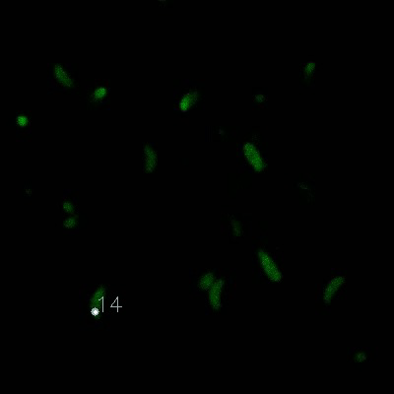
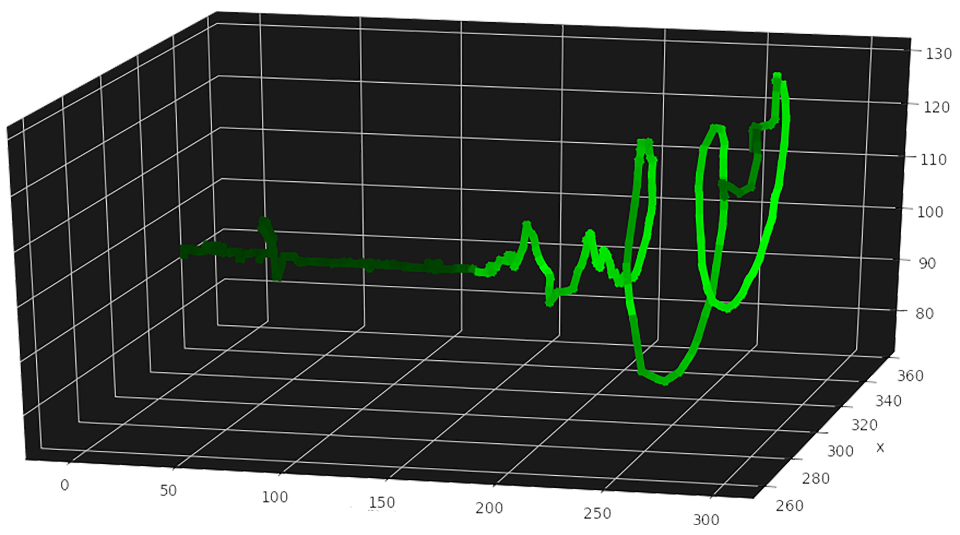
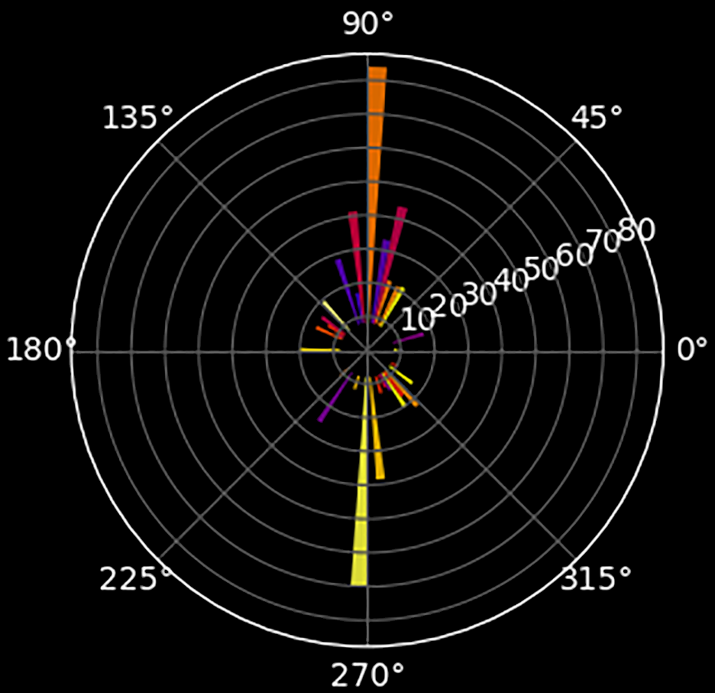
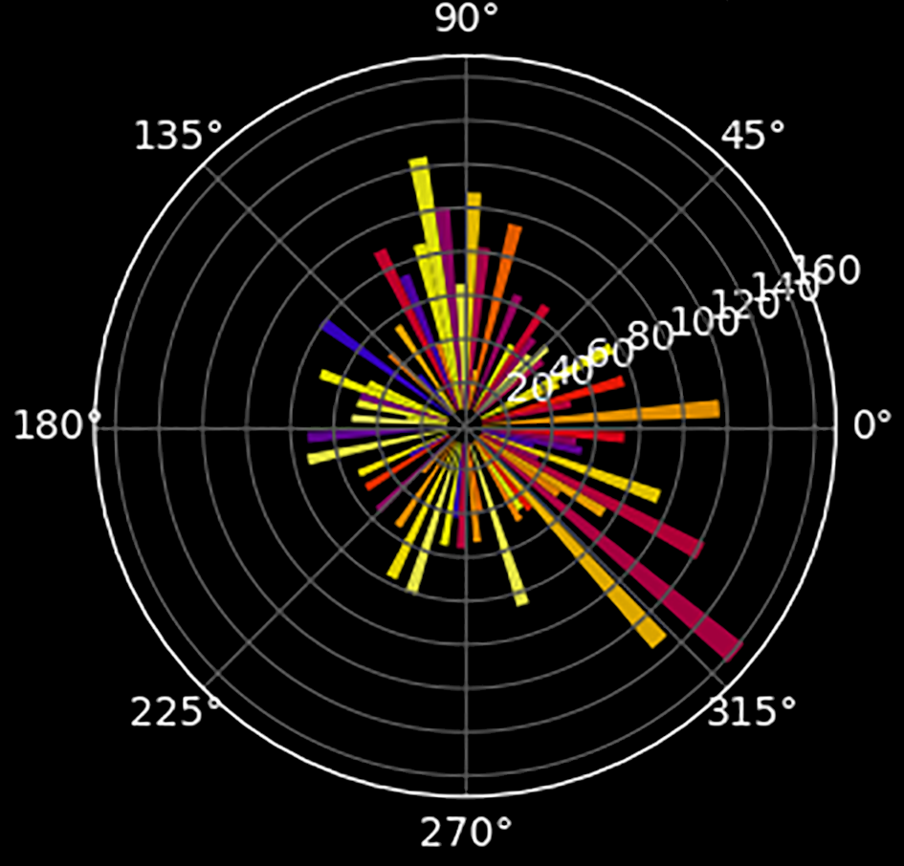
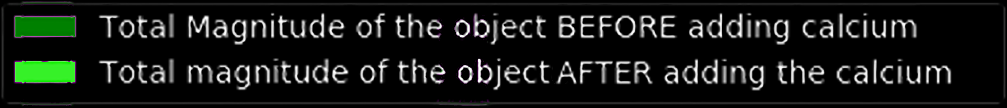
+ 1.8mM Ca²⁺
130
Ca²⁺
120
110
100
Y
90
80
360
340
320
300
X
0
50
100
150
200
280
250
300
260
Frames
3500
3000
2500
2000
1500
1000
500
Weighted
Cell 3
Cell 2
Cell 1
Cell 4
Cell 5
Cell 6
Cell 7
Cell 8
Cell 9
Cell 10
Cell 11
Cell 12
Cell 13
Cell 14
Cell 15
Cell 16
Cell 17
Cell 18

Slide 5
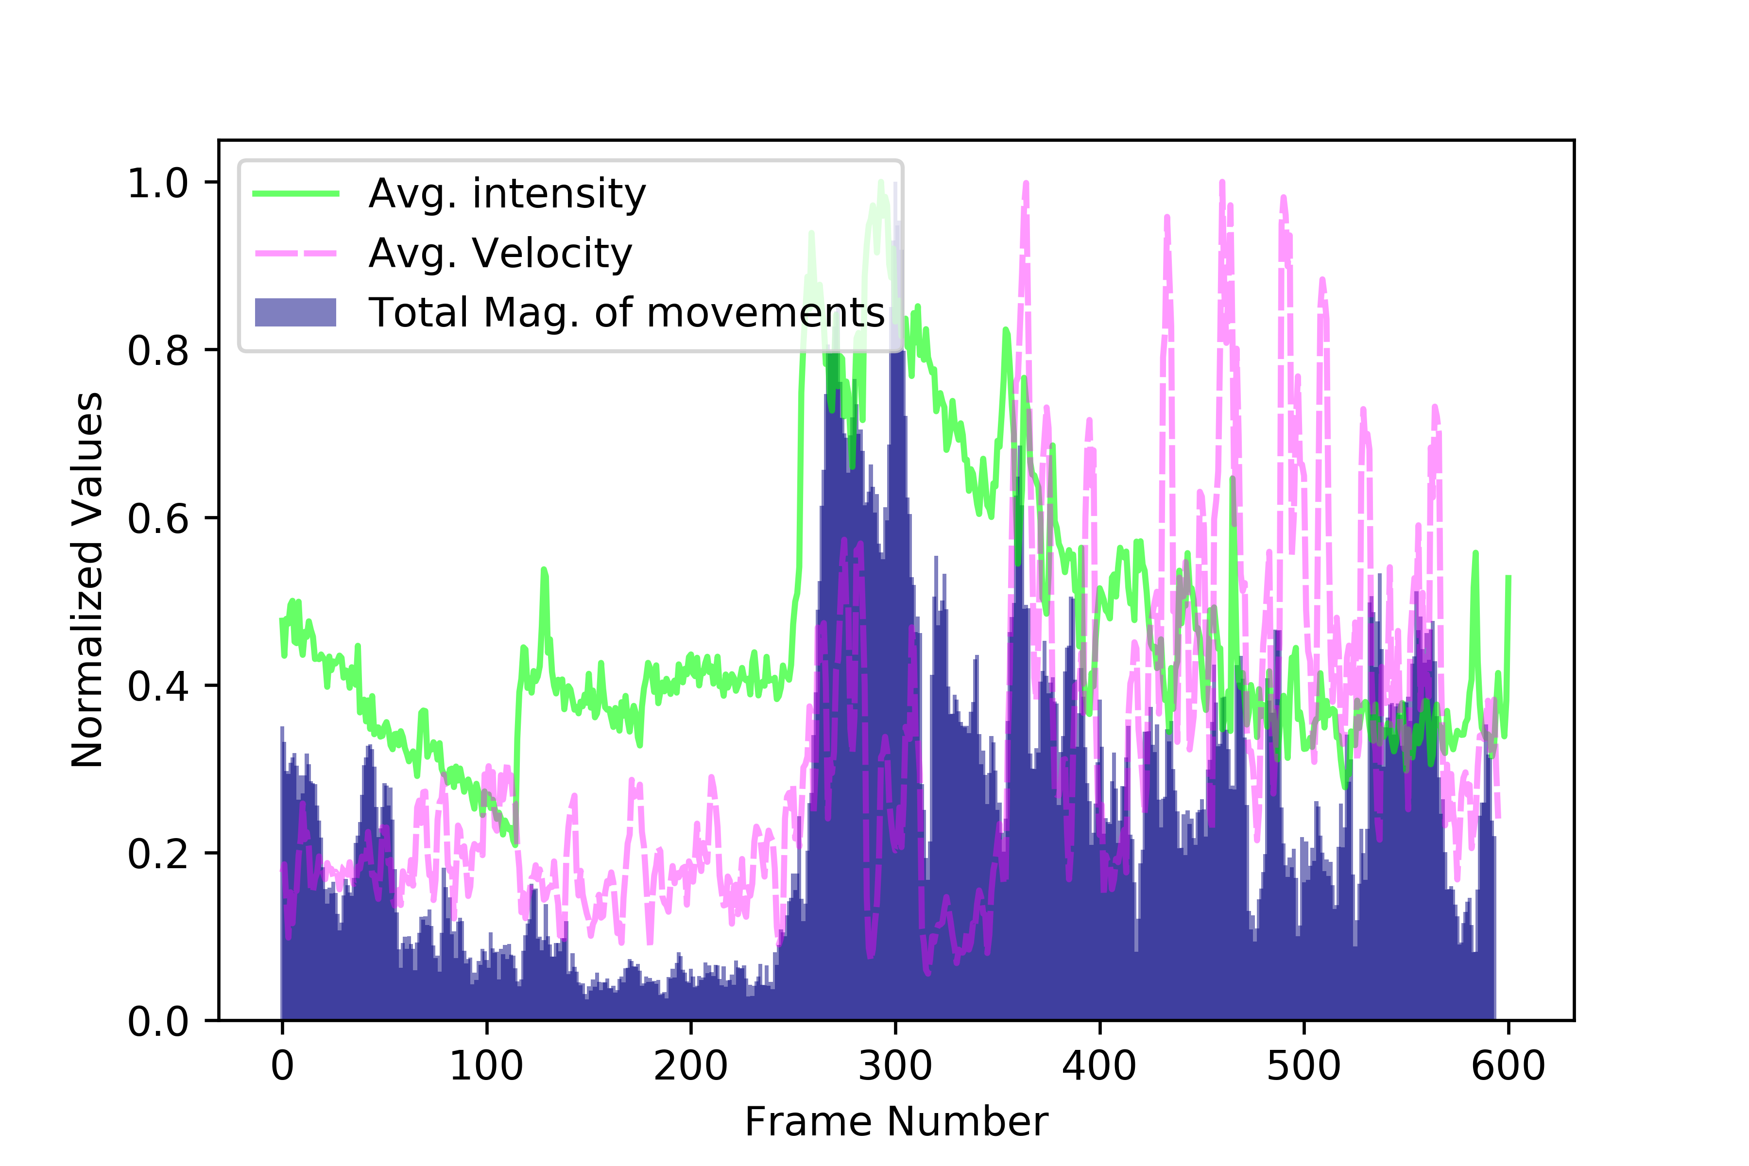
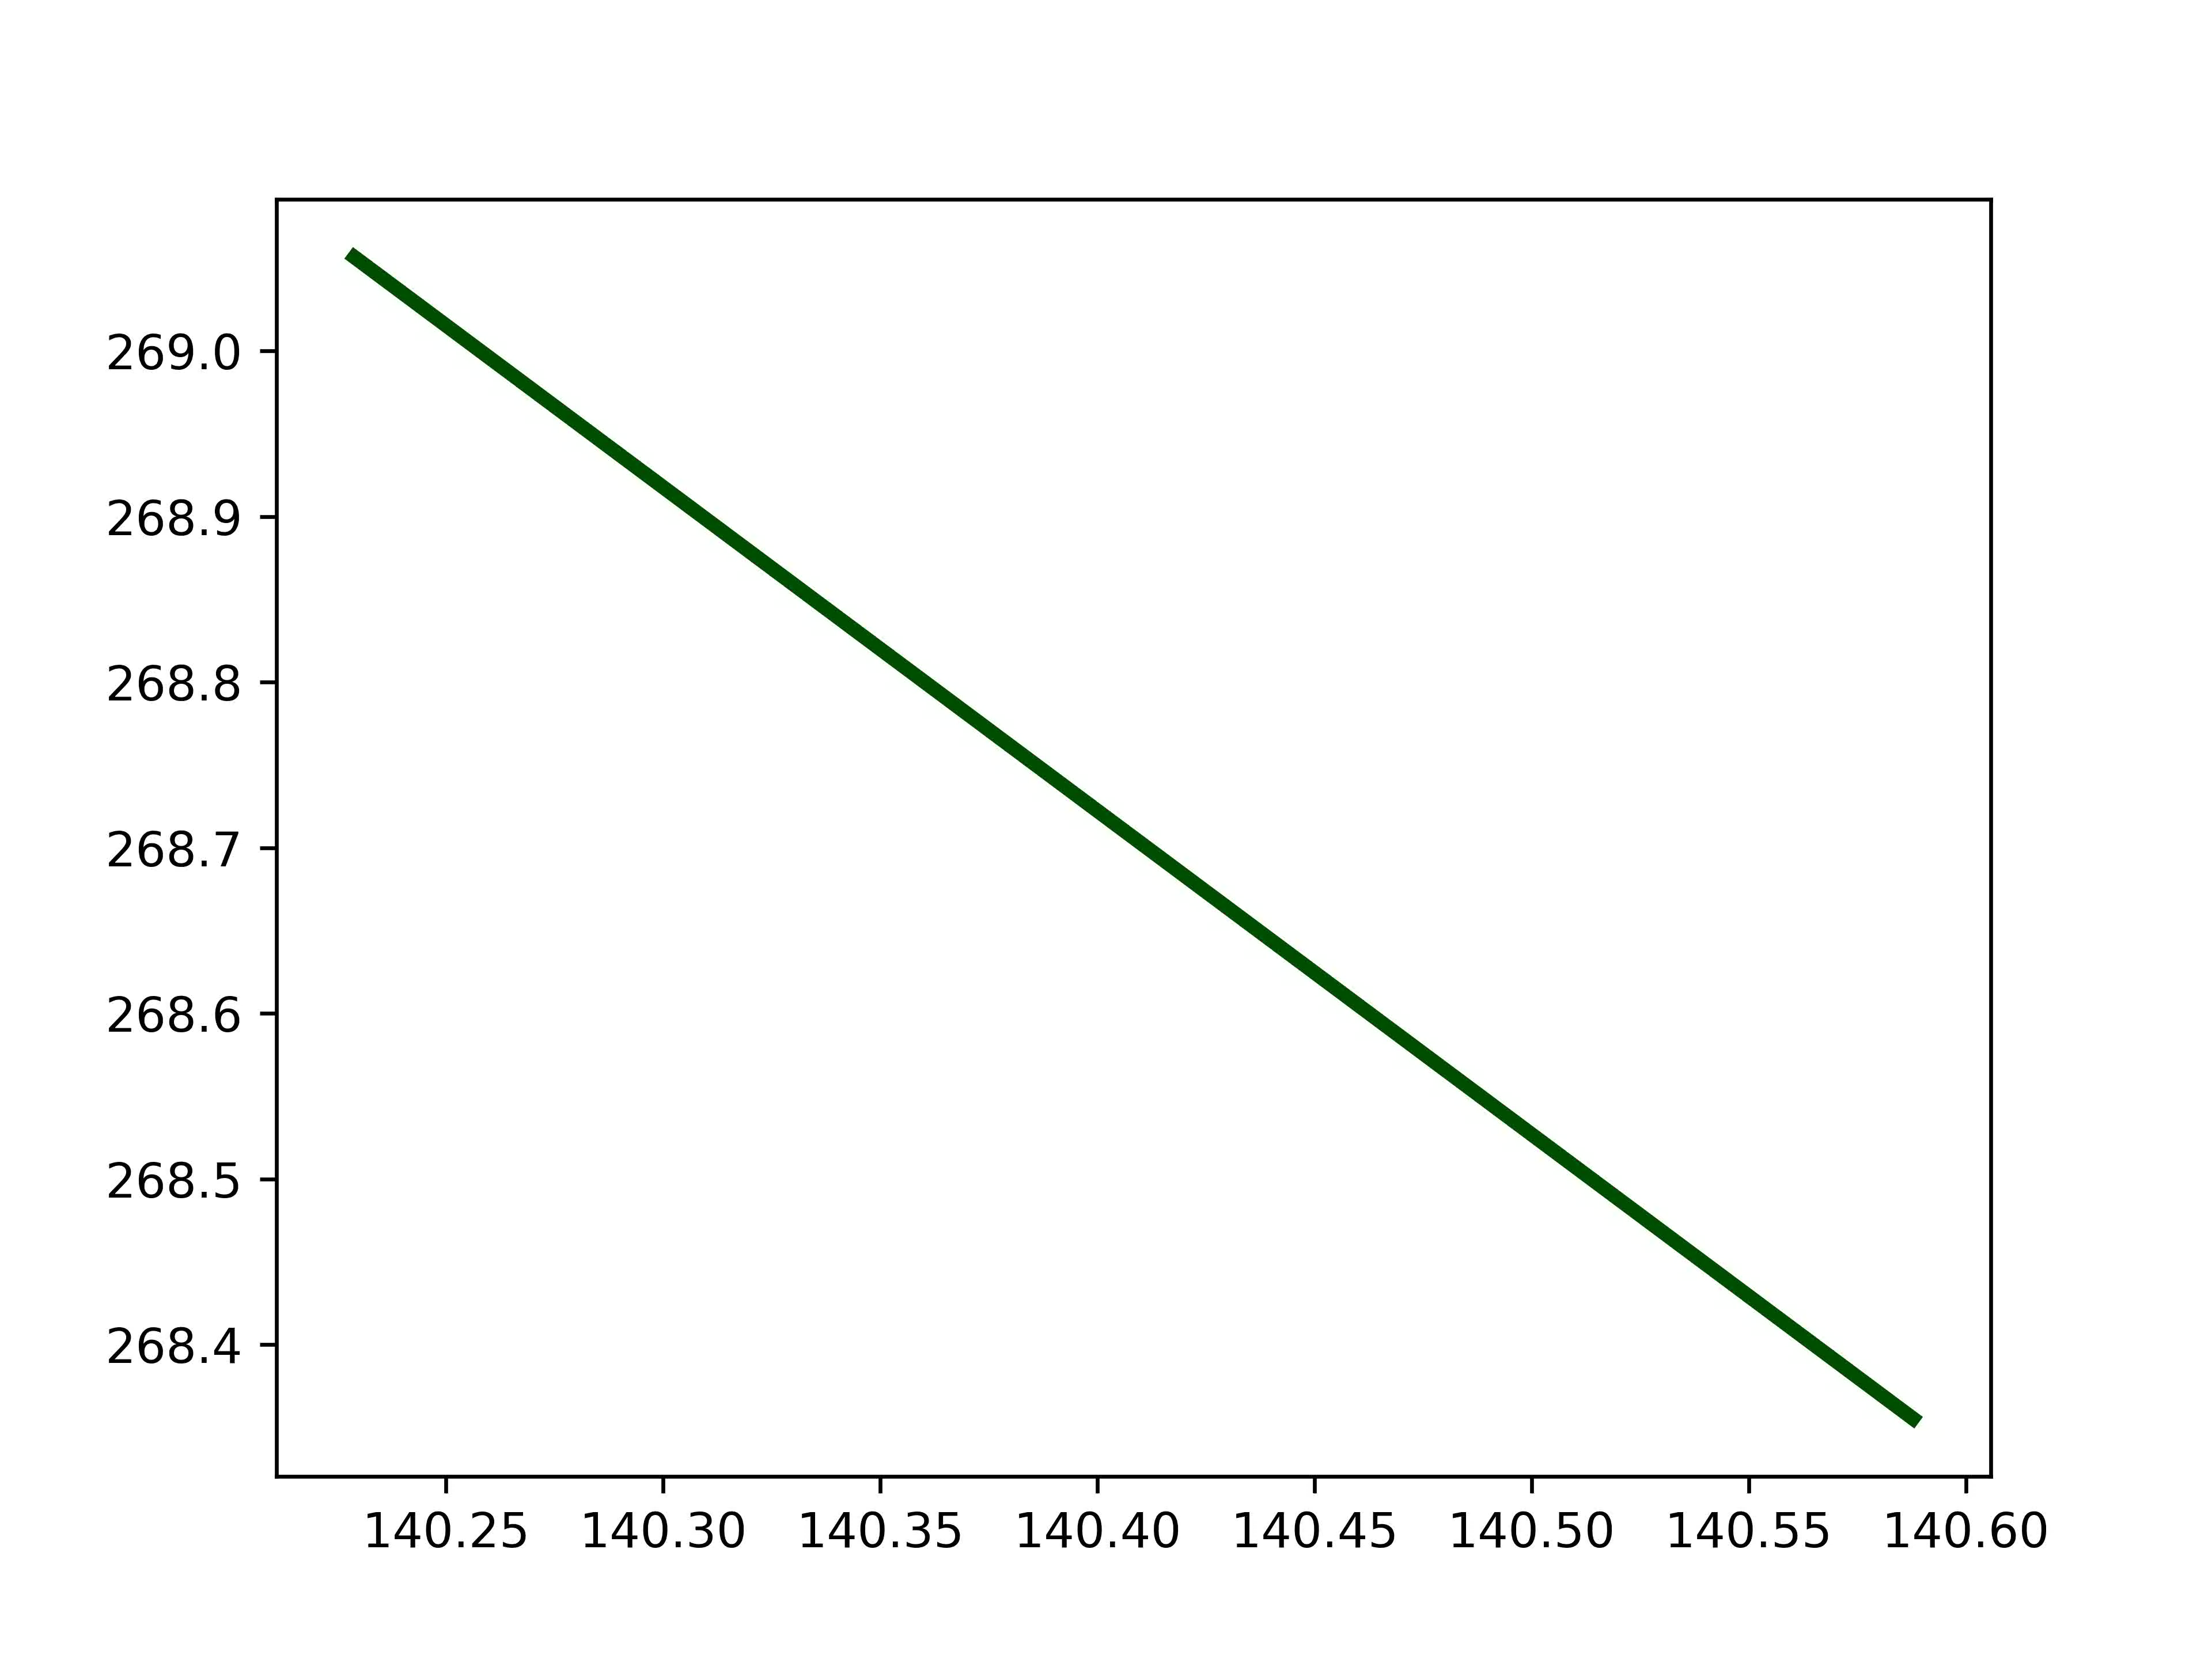
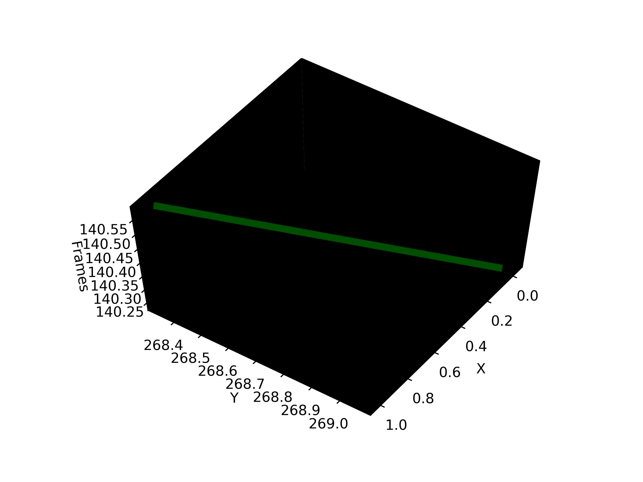
Spatiotemporal Analysis of Cell Trajectories in 2D Microscopic Videos
Y
Frames
x
Notes:
Misspelled “analysis” in title
I don’t understand how we got to this slide—we were just talking about T. gondii and you showed a video, but how did we go from that to this?
What’s the take-away from this slide? What point are you trying to make?

Slide 6
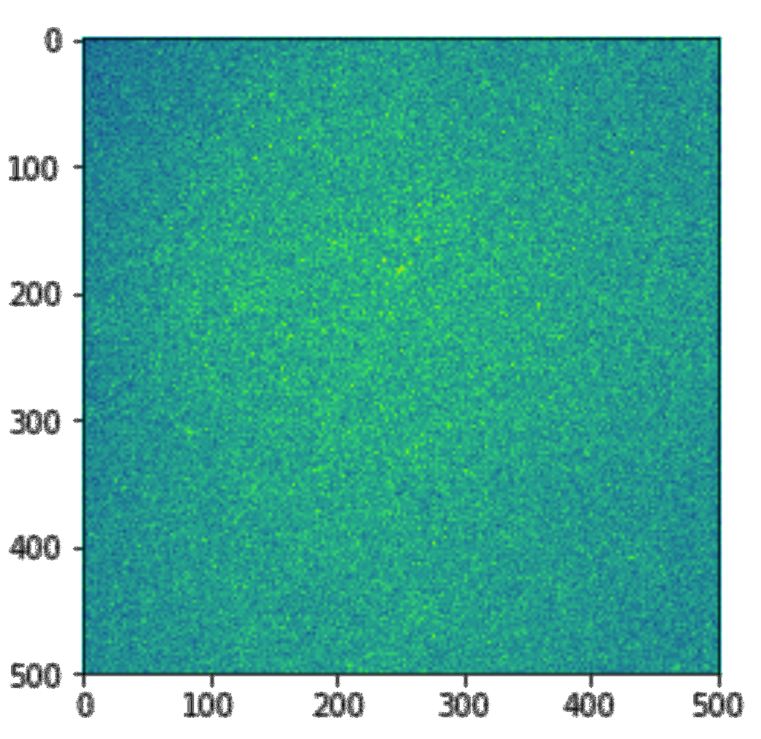
3D Microscopic video challenges:
Low quality images.
Difficulties on detections.
Large data sets.
Frame 1
Frame 2
Frame n
Notes:
The word “microscopic” refers to things being small; not the right word in the context of the title
-Maybe just say “3D confocal videos” or similar
Again, what is this point of this slide? What point are you making?

Slide 7
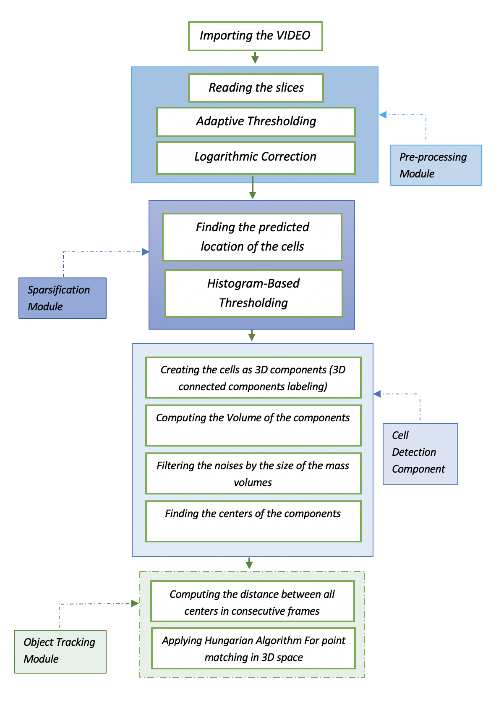
Computational Pipeline
Notes:
Don’t need “:” in title (ever)
Figure is way too small. If you want to use this figure, you’ll need to do one of several things:
Show the figure in pieces; that is, use animations to highlight certain sections, one at a time, so you can explain it to the audience
Only show one part of it at a time, perhaps showing one part and then another as you describe them through the talk
Highlight the modules (make that text REALLY BIG) to help give the audience the “big picture”

Slide 8
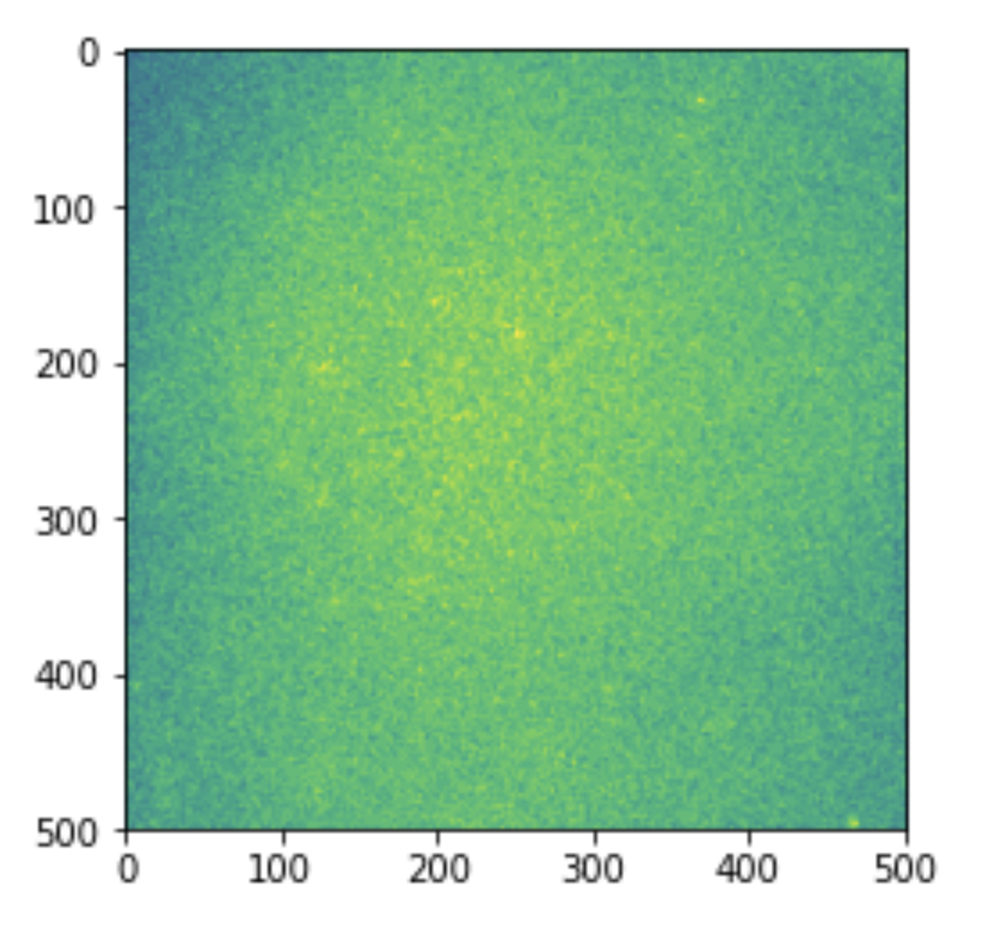
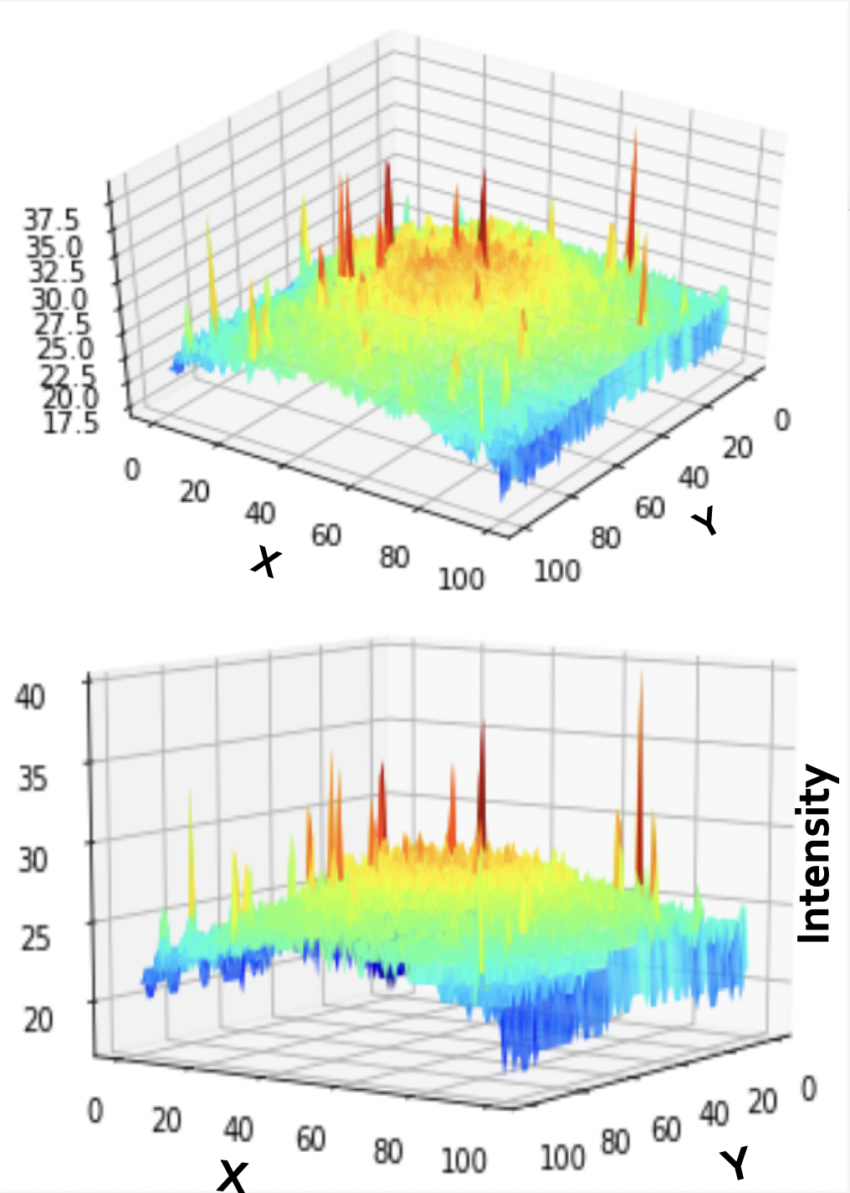
Preprocessing
The effect of dark corners
Notes:
No colons in title
Again, what is the point you are making on this slide? How does it relate to your original research question?

Slide 9
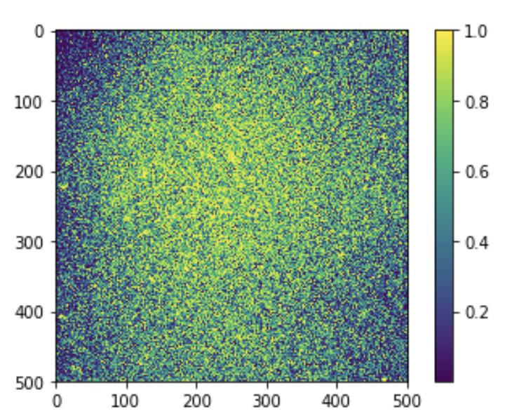
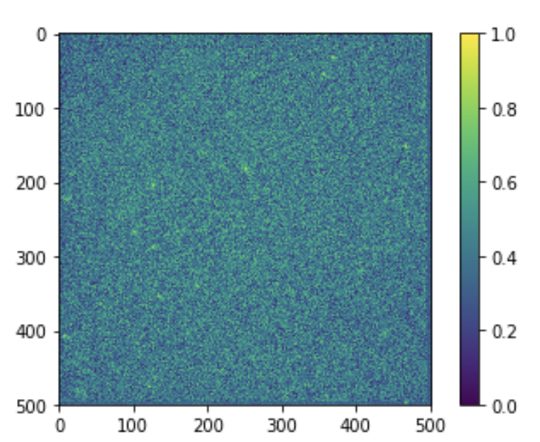
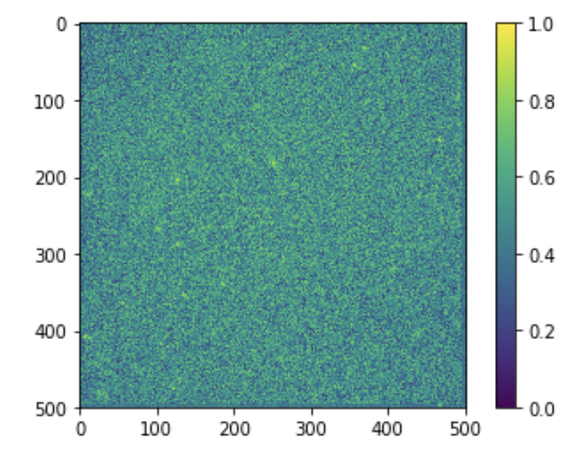
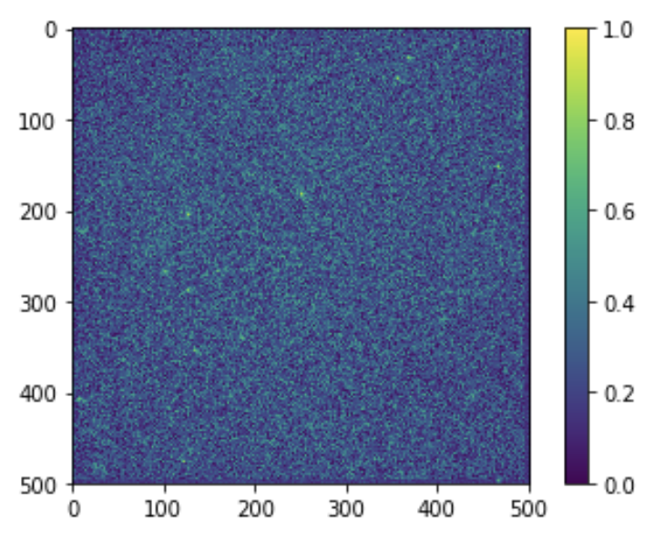
Preprocessing
Is there a way to decrease the effect of dark corners ?
Adaptive Thresh
Logarithmic Correction
Gamma correction
Notes:
No colons in title

Slide 10
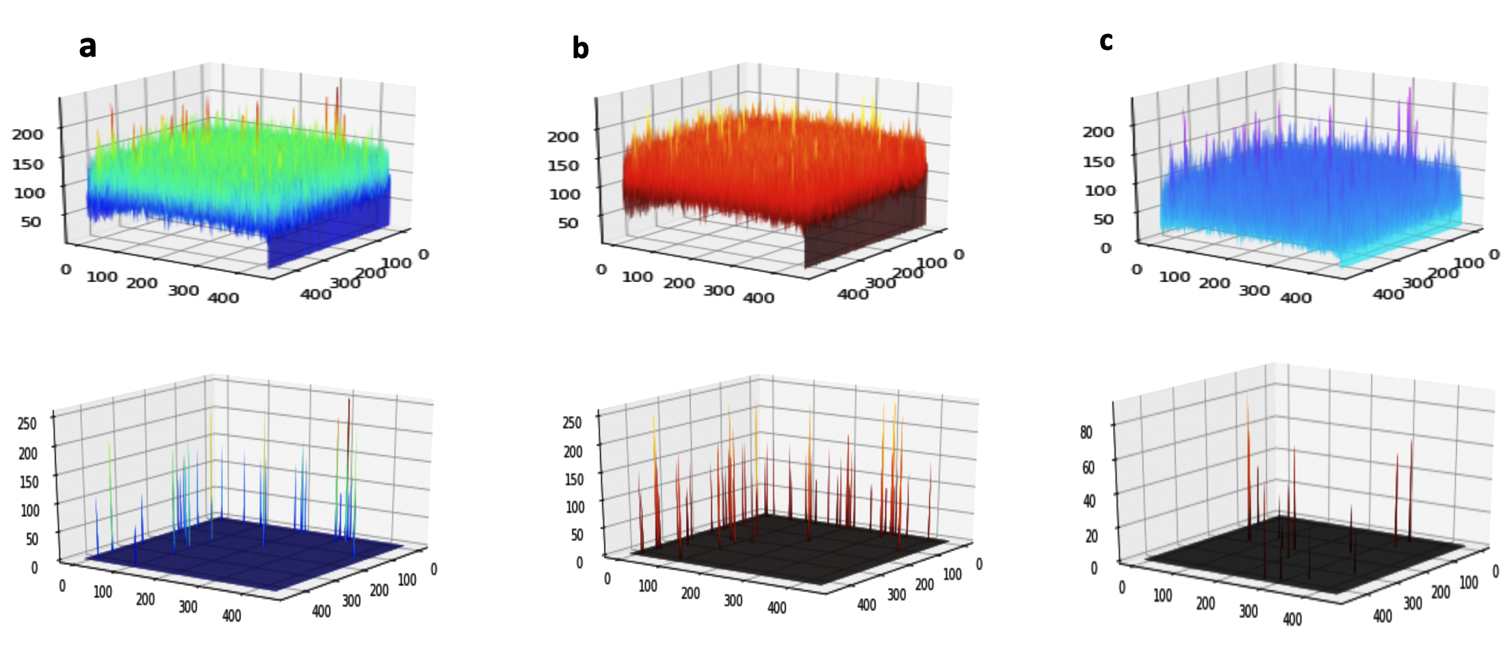
Selecting the Best Image
Notes:
Figures are way too small; audience won’t be able to see what their identifying features are
(on that note: what ARE their identifying features? More broadly, what is the point you are making on this slide?)
“thresholdings” is not a word—”thresholds” is the plural of “threshold”

Slide 11
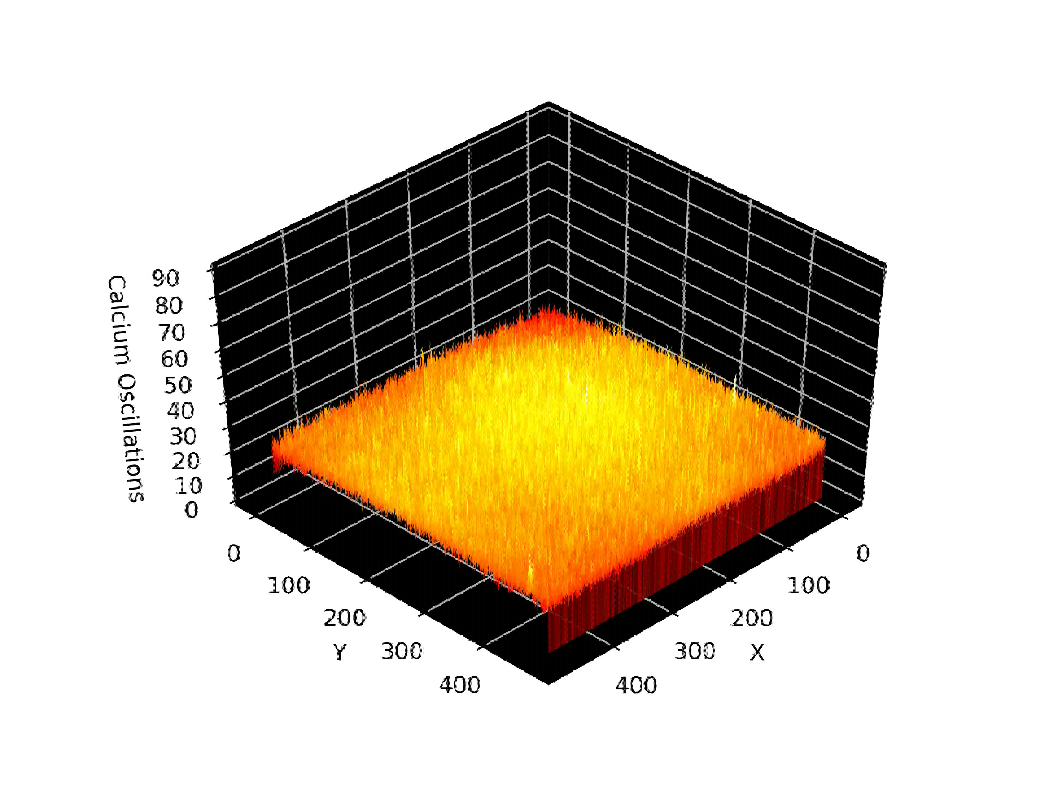
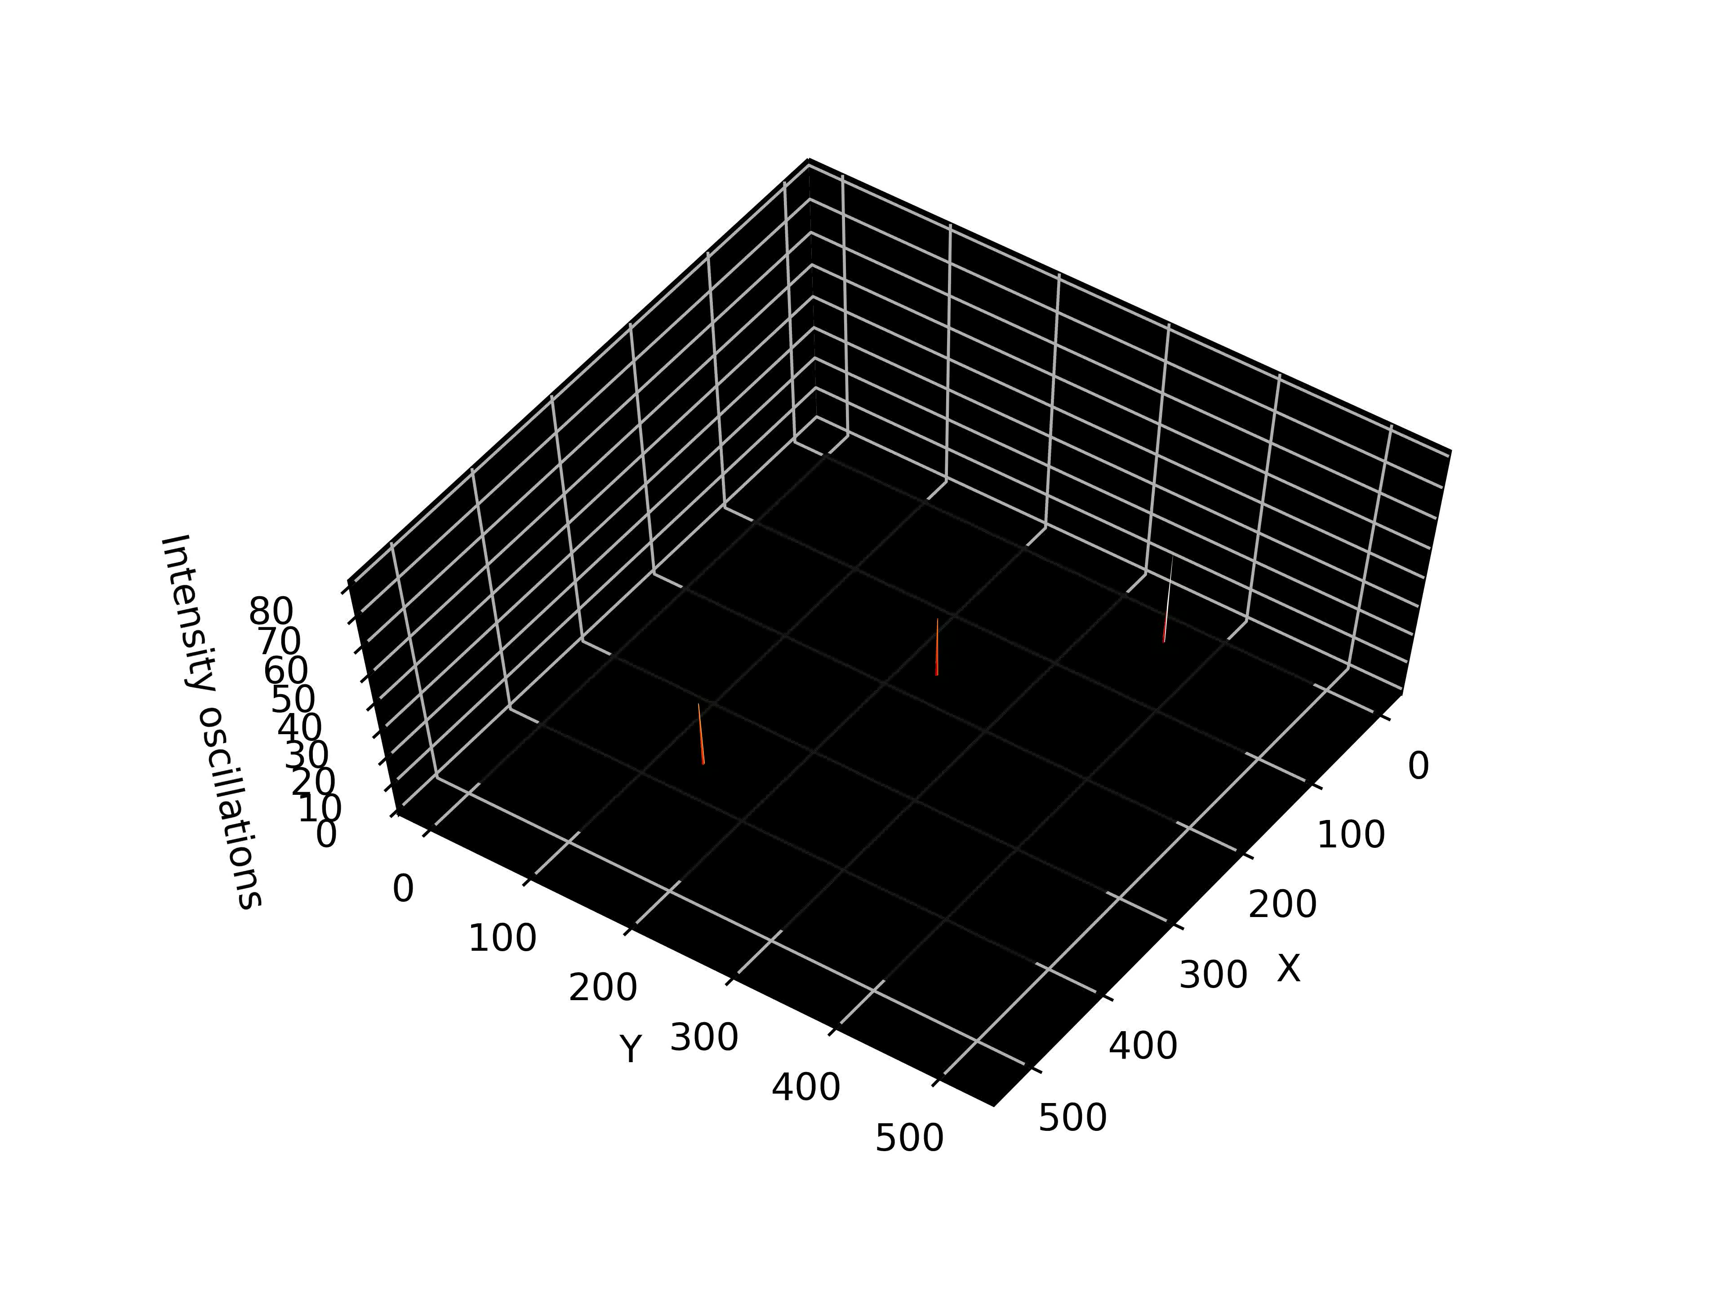
Thresholding and Sparsification
Intensity Oscillation
Notes:
No colon in title
What is the point you are making in this slide? How does it relate to your original research question?

Slide 12
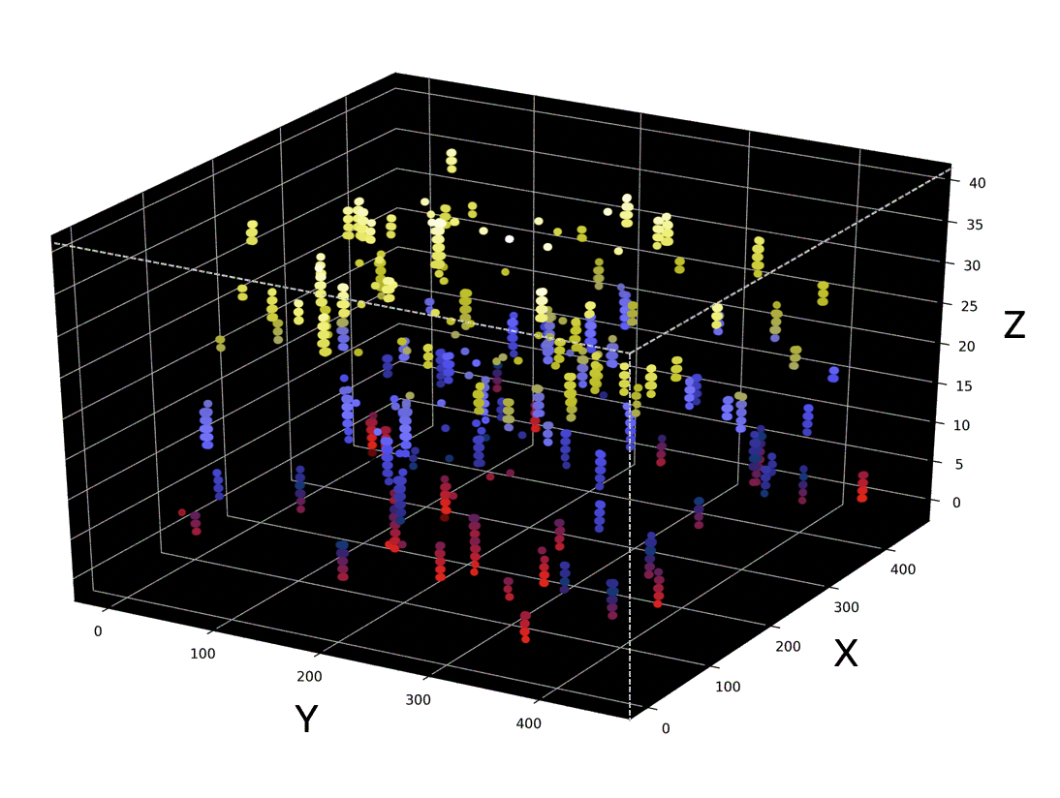
Unifying the Cell particles
First: Representation of the potential locations of the particles: by finding the locations of the intensity spikes and visualizing them in 3D space, we are trying to have an understanding about the locations of the cells.
Notes:
No colon in title
Why do the particles need to be “unified”? What does this mean? How does it relate to your original research question?

Slide 13
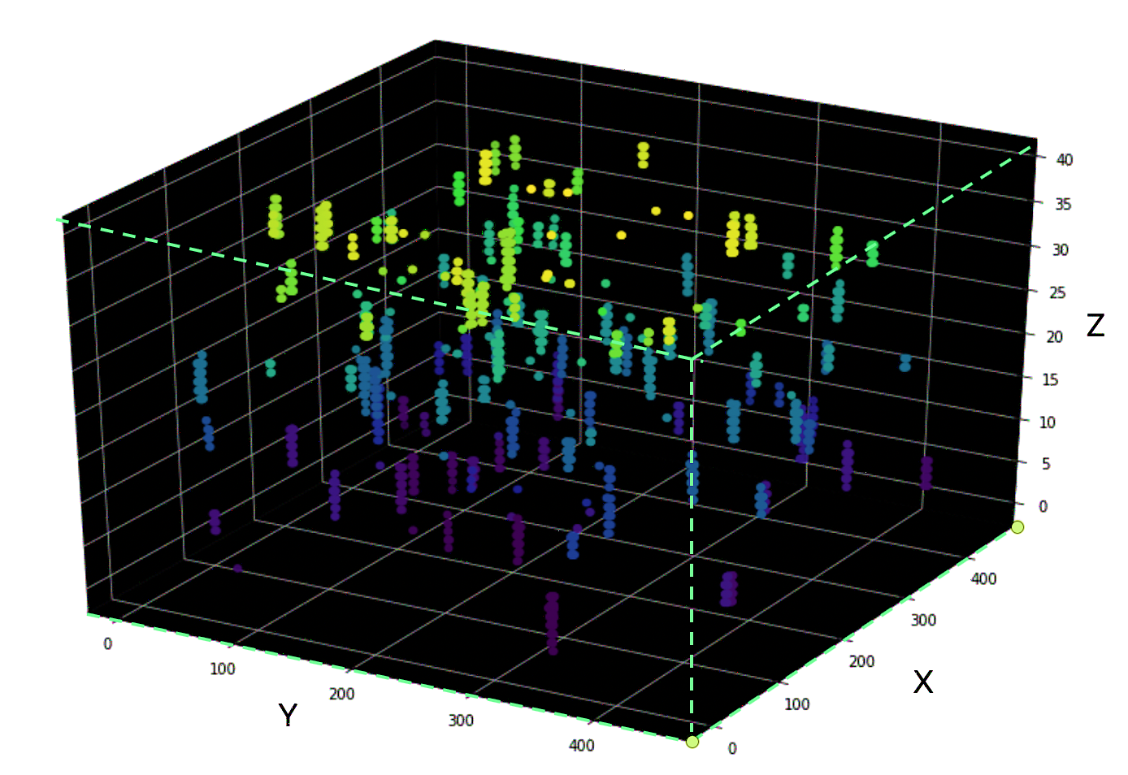
Applying 3D connected components labeling!
Unifying the Cell particles
For tracking we need to have all cell’s point integrated as a single component.
Notes:
No colon in title

Slide 14
Comparing the detected cells with the ground truth
ground truth
Our result
After creating the components we overlayed all 63 frames to check the results with the ground truth!
Notes:
Title is too colloquial—make it an overview statement of this slide’s point/take-away
Should be “ground truth”, not “ground through”

Slide 15
Comparing the ground truth with centers of masses
ground truth
Our result
The comparison shows that the results with center of masses is more closer to the ground truth.
Notes:
Title is too colloquial again (this is something you should say out loud, not write in a slide title)
No colon in the title
Same with the text below the title—this is something you should say out loud, not write as text

Slide 16
Removing the noise
By computing the volume of each component and filtering out the small components, we removed the false positives from our data !
ground truth
Our result
Notes:
No colon in title
“noise” is both singular and plural by itself
Text below title is a fragment, seems to be a word missing somewhere

Slide 17
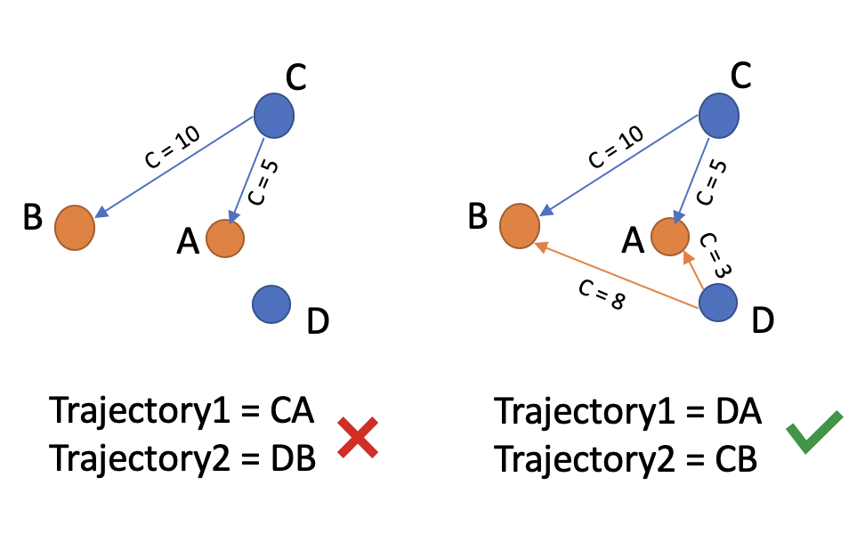
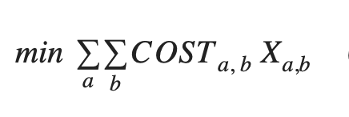
Tracking the Cells
After extracting all the centroids of the masses, we have a jagged list of the centers.
We used Hungarian Algorithm for tracking the cells :
The problem of local assignment :
we need to set a distance threshold on the distance between two points not exceeding the defined value in two consecutive frames.
Notes:
No colon in title
This feels out of order—you already showed excellent tracking results in the last slide. Why are we now going back to show how the tracking was done?

Slide 18
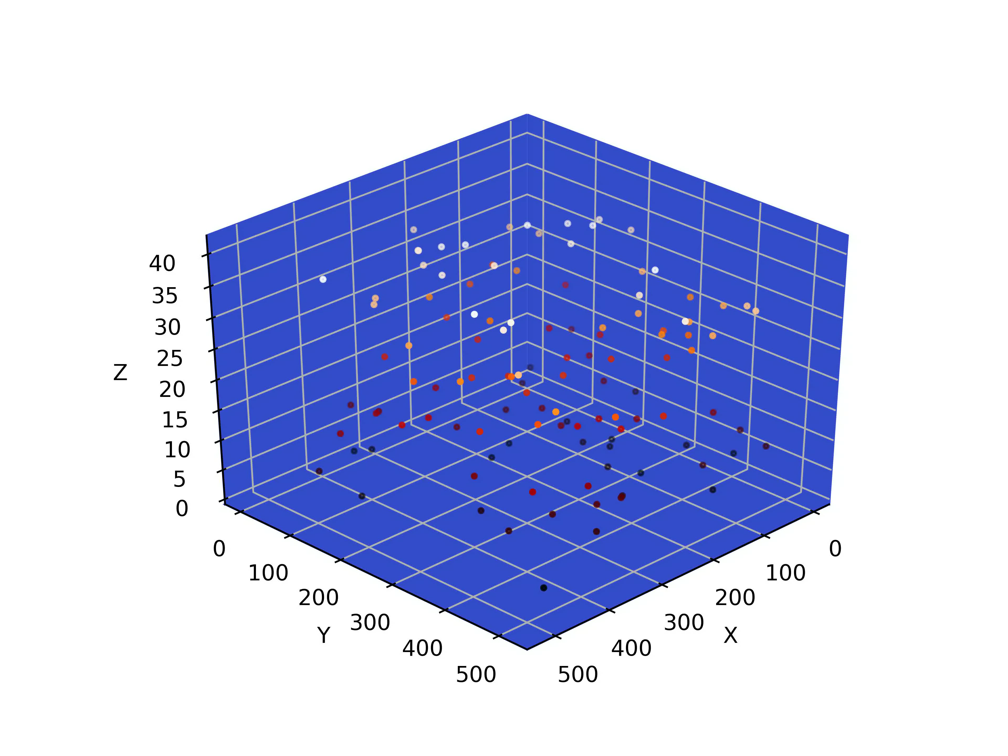
Let’s see how the objects are moving across the time !

Slide 19
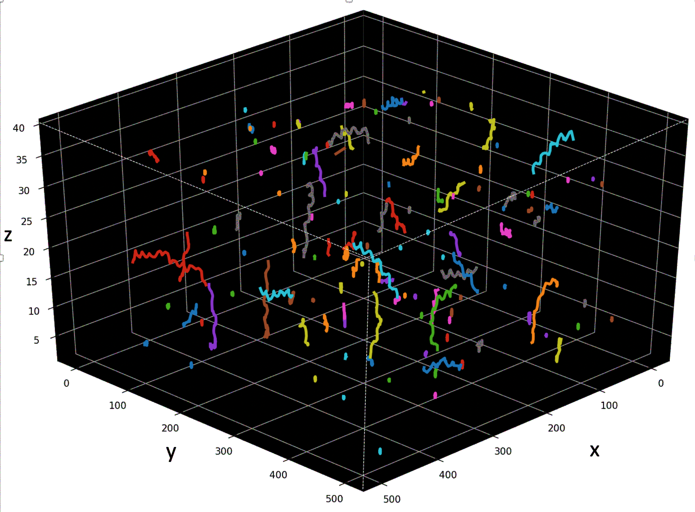
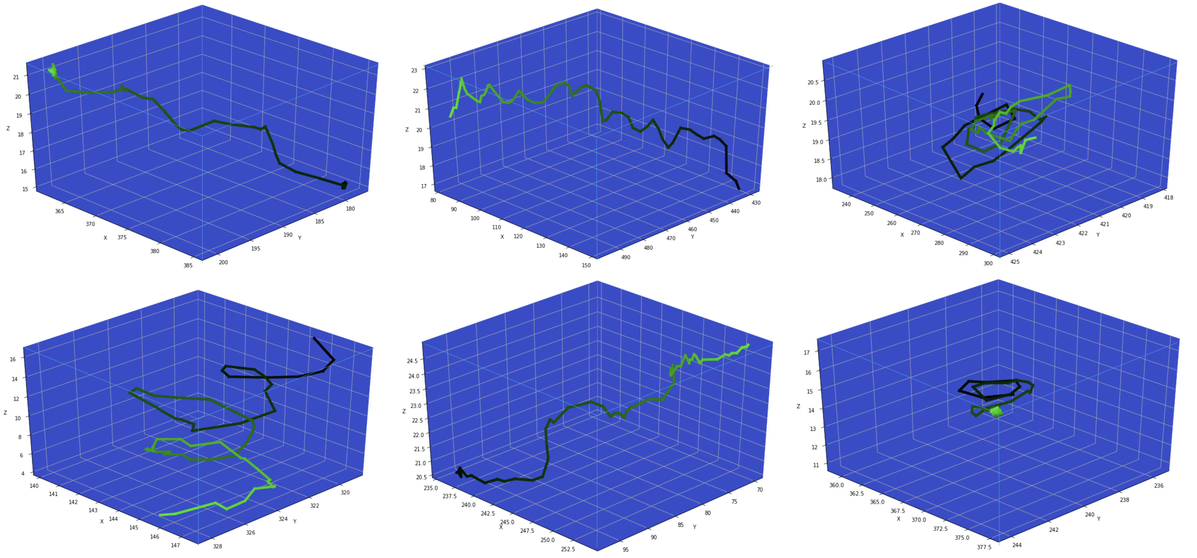
Tracking results
Aggregated result of the tracked cells trajectories in a single plot
4D Representation of spatiotemporal dimensions of the tracked cells across a video
Notes:
No colon in title
Also: some frames have fully capitalized titles (like this one), others do not. You need to be consistent across slides.

Slide 20
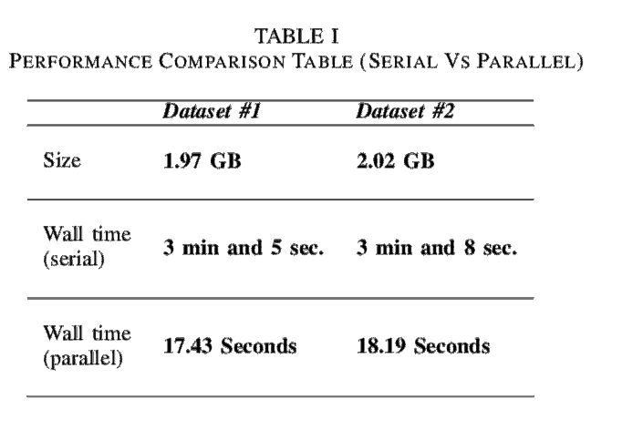
Framework Parallelization
First we identified the bottlenecks :
Preprocessing module
Thresholding part in Sparsification module
3D connected component part in Detection module
Computing the center of the mass in Detection module.
Computing the mass volumes and filtering out the false positives in Detection module
Notes:
No colon in title (also this is a slide where the title is NOT fully capitalized; not a problem either way, just pick one and be consistent)
The last three bullets are all “Detection module”—is that correct?

Slide 21
Conclusion and Future work
In this research, we developed a computational pipeline for cell tracking and detection in 3D microscopic videos. We developed a parallel version of our framework using “joblib” and “multiprocess” libraries of Python. The parallel version shows an order of magnitude improvement in runtime over the serial version. As this is only an initial implementation, we anticipate additional performance improvements we refine our methods.
In the future we plan to concentrate more on two points.
improving the computational performance of our pipeline and its scalability using other distributed systems solutions like dask or Apache Spark.
we hope to use more robust methods to remove sources of noise in the images, such as generative adversarial networks (GANs) to learn noise distributions and perform deconvolutions.
Open Science in Big Data Workshop – IEEE Bigdata 2018, Seattle, WA
Dec, 10,2018
Notes:
“futurework” is two words
No colon in title
Don’t need words “first” and “second” in the bulleted list; that’s kind of the point of having a bulleted list!

Slide 22
Thank you !

